Slide 1

ATM MANAGEMENT SYSTEM
:Presented by Group 3

Slide 2
SUBMITTED BY:
NAME ROLL NO
1. Sarveshwar Neogi 1828097
2. Satyajit Biswal 1828098
3. Saumya Priyadarshini 1828099
4. Sayantani Chakroborty 1828100
5. Shambhavi Sharma 1828101
6. Shiladitya Roy 1828102
7. Shivam Narayan 1828103
8. Shreyo Sinharoy 1828105
9. Shwetaleena Sahoo 1828106

Slide 3
ACKNOWLEDGEMENT
It is a great pleasure for us to acknowledge all those who have contributed towards the conception, nurturing, and completion of this project, on
ATM Management System.
Many guides have contributed to the successful completion of this project. We would like to express our profound gratitude to each one of them.
We are grateful to our Dept.,'School of Computer Engineering' which provided us an opportunity to prepare this project in our 3rd semester, which helped us develop our coding and analyzing skills.
We would like to thank our parents & friends for giving us their tireless support through thick and thin. Our special thanks to our teacher
Mr. Mahendra Kumar Gourisaria who gave us his expert guidance, whenever necessary.

Slide 4
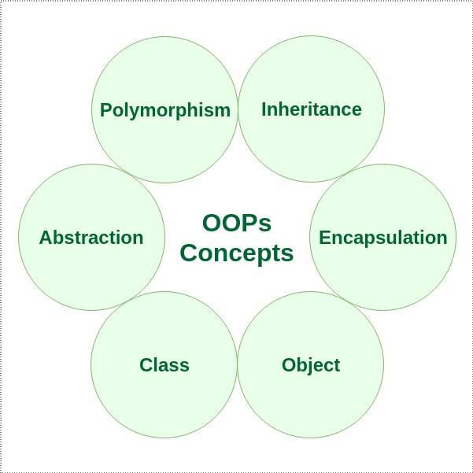
Characteristics of Object Oriented Programming

Slide 5
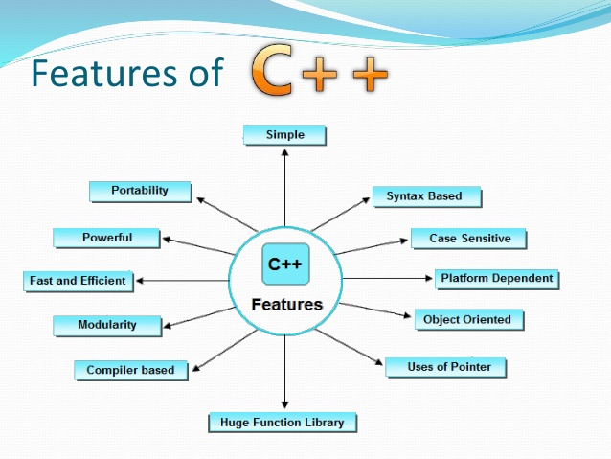
Why C++ ?
The simple context of C++ gives an appeal to programmers, who are eager to learn a new programming language.
The language treats the uppercase and lowercase characters in a different manner. For instance, the meaning of the keyword ‘cout’ changes if we write it as ‘Cout’ or “COUT”.
C++ is a compiler based language and hence it is relatively faster.
The C++ programming language offers a library full of in-built functions. These functions can be accessed by including suitable header files.
C++ is compiler-based, hence it is much faster than other programming languages like Python and Java that are interpreter-based.

Slide 6
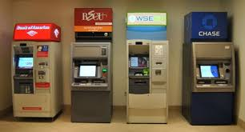
INTRODUCTION
An automated teller machine (ATM) or automatic banking machine (ABM) is a computerised telecommunications device that provides the clients of a financial institution with access to financial transactions in a public space without the need for a cashier, human clerk or bank teller. On most modern ATMs, the customer is identified by inserting a plastic ATM card with a magnetic strip or a plastic smart card with a chip, that contains a unique card number and some security information such as an expiration date or CVVC (CVV). Authentication is provided by the customer entering a personal identification number (PIN).The main purpose of the ATM division and information service is to provide the customers financial flexibility, worldwide acceptance and round-the clock convenience.

Slide 7
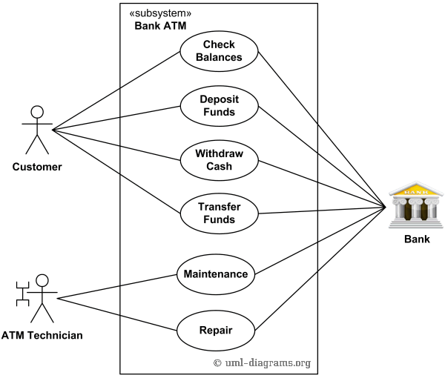
Architecture of ATM Management System

Slide 8
Purpose of ATM
ATM management system is a centralized monitoring unit, involved in strategic planning and implementation of ATM services so as to manage, monitor, and register ATM events. The system is liable to monitor the surveillance of the machine, and detecting and removing errors at a very short notice.
Instant Balance enquiry.
Printing of Transaction list.
Change of Pin.
Cash Withdrawal.
Cash deposit.
Bill payment.

Slide 9
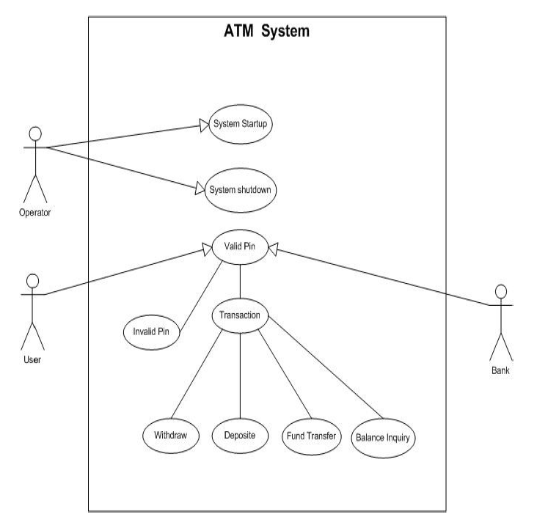
Use Case Diagram:

Slide 10
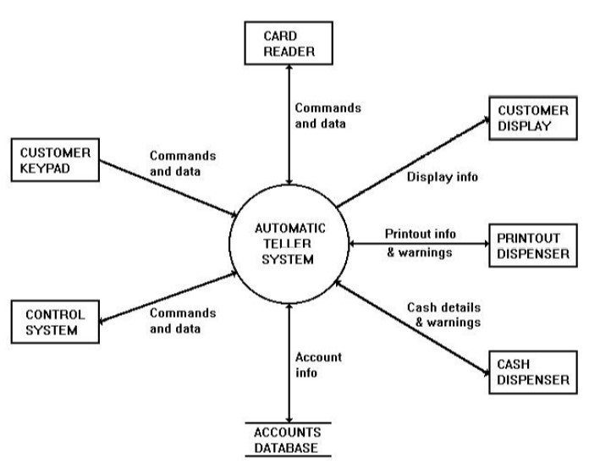
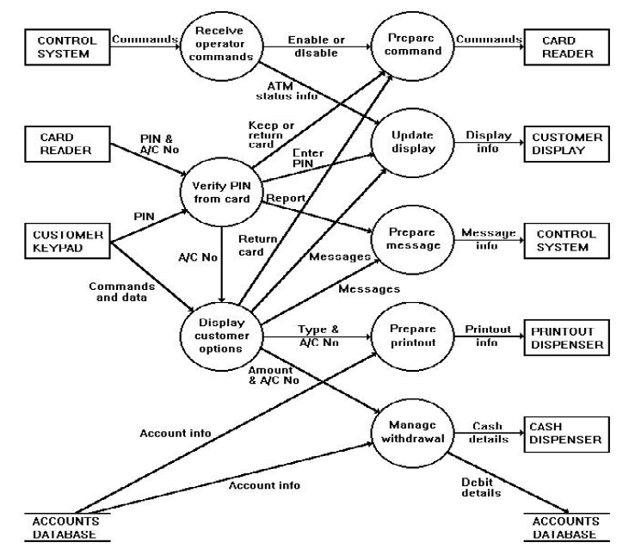
Data Flow Diagram for an ATM
Level 1: Level 2:

Slide 11
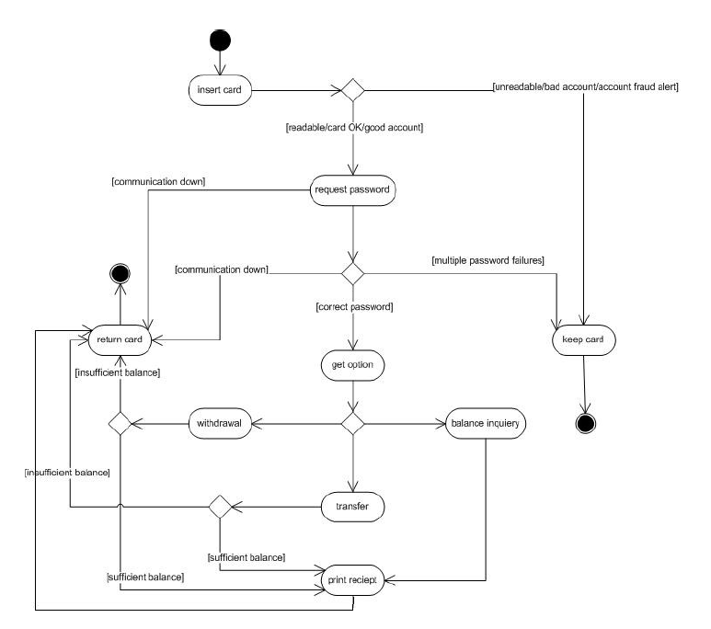
Activity Diagram

Slide 12
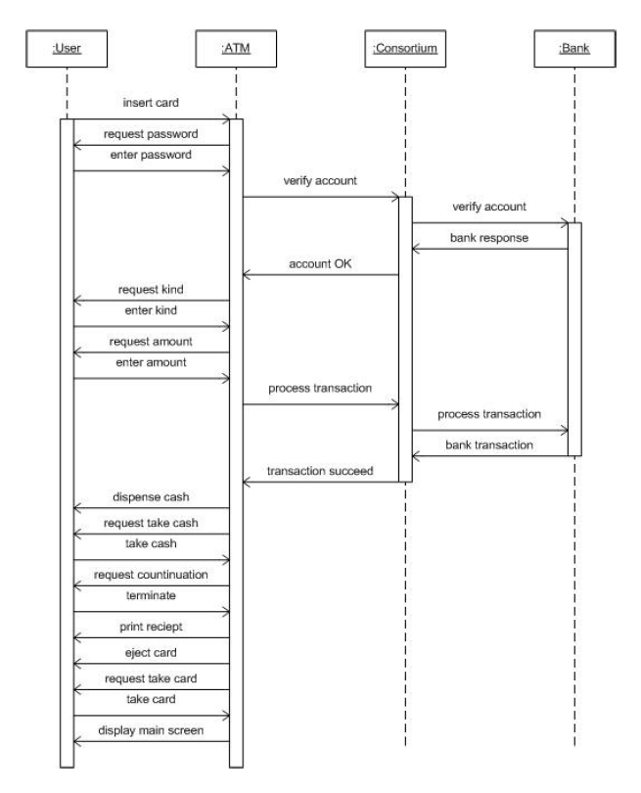
Interaction Diagram :

Slide 13
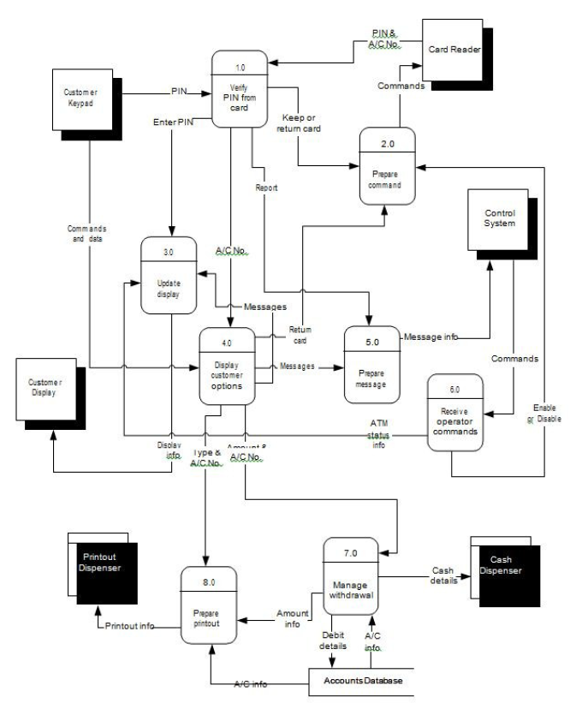
Control Flow Diagram

Slide 14
CONCLUSION
Back in 1969, Chemical Bank announced that a new form of banking was being launched. Customers were provided with plastic cards designed with a magnetic strip that could be used with a machine built into a wall. Gone were the days of having to stand in line for a teller, or not having money on hand after normal banking hours. Almost everyone has used or at least heard of an ATM. Interestingly some people feel that ATMs are the best thing to happen to the banking world, while other people consider them to be a curse. One of the Major drawbacks of the ATM was the lack of jobs it created. Regardless of what we may think, ATMs have no doubt revolutionized the world and the way we deal in money. For example, how many times have we been out somewhere only to discover that we have no cash and we are out of checks. But just around the corner, there is an ATM. We swipe a card and voila!, we now have cash on hand. In addition to dispensing money, ATMs also make it convenient to deposit money, transfer money, and check balances. All of this, without the hassle of visiting a bank. ATMs can be found in grocery stores, in shopping malls, along roads, in the Buckingham Palace, in airports, in casinos, even on the South Rim of the Grand Canyon, and of course in banks. For these reasons, ATMs are one of the most remarkable inventions of their time.

Slide 15
REFRENCES/BIBLIOGRAPHY
Some of the sites which have helped us tremedously to complete our project are as follows:
www.stackoverflow.com
www.programmingsimplified.com
www.geeksforgeeks.com
www.cplusplus.com
www.programmiz.com
Text book reference:
Object Oriented Programming : E.Balagurusamy (Mc Graw Hill)

Slide 16
Thank You!

